Slide 1

Heritage Arboretum Development Project
GROUP-1
Bothsa, Indrani
Saraswat, Gaurav
Singh, Neha
Wadhwa, Vaishnavi Gopal

Slide 2
AGENDA
CASE STUDY
WHY AGILE?
PRINCIPLES AND VALUES
MVP AND VISION
KEY STAKEHOLDERS
PRODUCT ROADMAP
SUSTAINABLE PACE
CONCLUSION

Slide 3
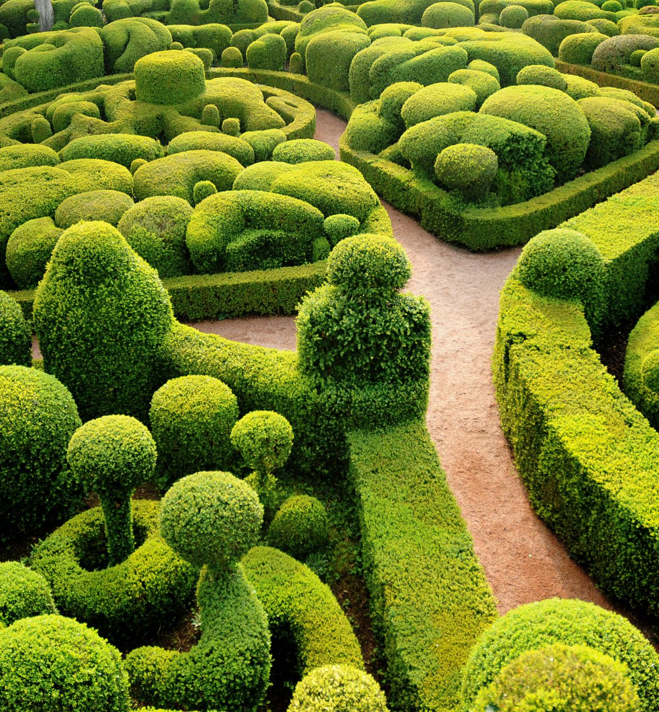
CASE STUDY
In this case study, we will delve into how we applied Agile methodologies to navigate the complexities of establishing the arboretum. We’ll explore how embracing simplicity, adapting to change, and maximizing value helped us meet our objectives effectively. Join us as we uncover the strategies, challenges, and triumphs in making the Heritage Arboretum a cornerstone of green space and learning for generations to come.

Slide 4
Why is an Agile approach suitable for this project?
Iterative + Incremental Progress
Flexibility
Stakeholder Involvement
Responding to change
Notes:
Incremental Progress: The project's nature lends itself well to an iterative method because it involves large-scale change and frequent replanning (such as where to plant different kinds of trees).
Flexibility: Modifications based on feedback from stakeholders may be made during the project, such as adjusting the buffer zone between the grass and the woods.
Stakeholder Involvement: To support these concerns against the community's standards, stakeholder feedback and communication (such as from the Tree Committee and Trustees) is essential.
Uncertainty and Experimentation: Agile's flexible planning allows for controlled experimentation. Examples of exploratory activities include planting trees and monitoring their growth.

Slide 5
What Agile principles and values will be important and why?
Accept Simplicity
Embrace Change
Maximize Value
Provide and Respond to Rapid Feedback
Notes:
Accept Simplicity: Implement straightforward, high-impact actions.
Embrace Change: Adapt plans as new challenges or opportunities arise.
Maximize Value: Focus on tasks that deliver significant benefits.
Provide and Respond to Rapid Feedback: Use continuous stakeholder feedback to guide and refine project activities.

Slide 6
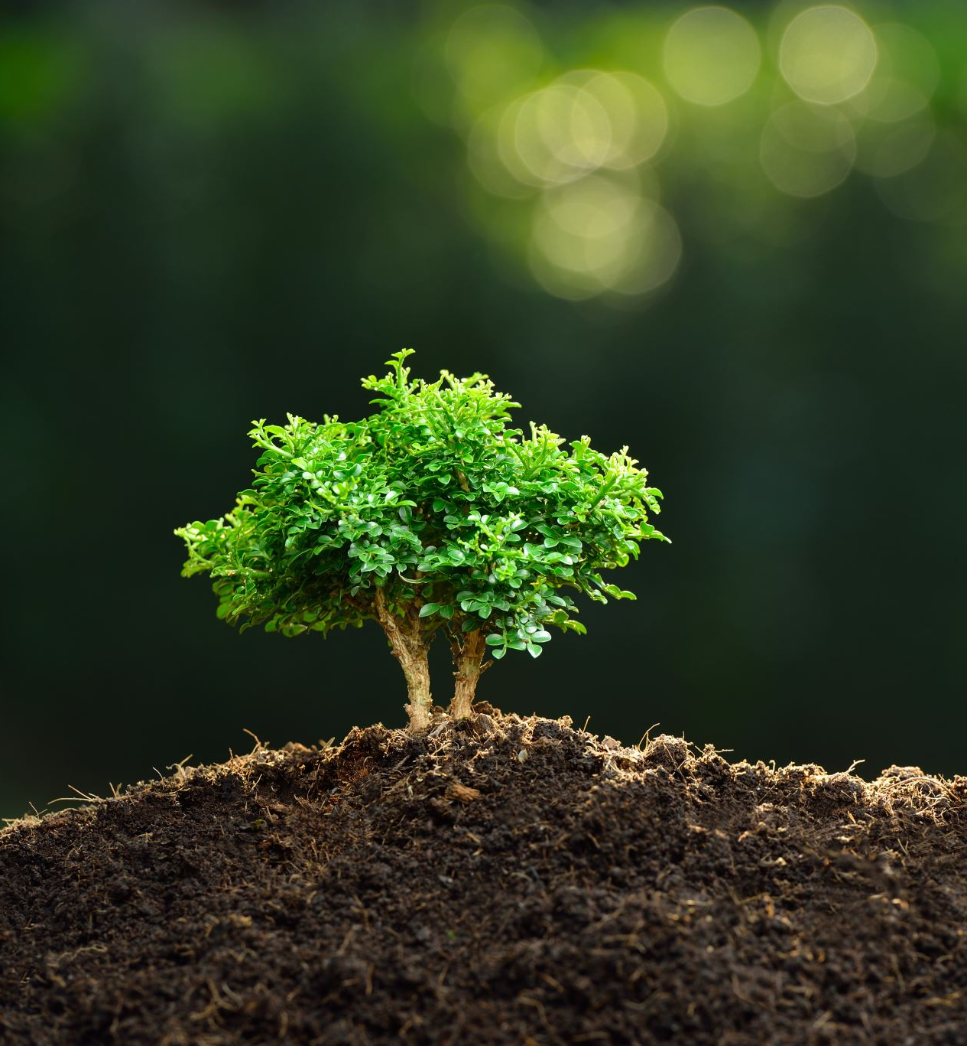
What is the Minimum Viable Product (MVP) goal?
The MVP goal is to secure Level One arboretum certification. This involves:
Installing informative tree signage.
Submitting a complete certification application.
Creating and publishing a high-resolution site map.
Conducting at least one educational event to fulfil certification criteria.

Slide 7
What is the vision statement for the project?
Promote
Native Tree Species.​
Enhance
Community Beauty.​
Achieve
Educational Goals.​
Secure and Maintain
Certification.​
Plan
Future Development.

Slide 8
Who are the key stakeholders, and how can they be engaged effectively?
Township Trustees​
Township Administrator ​
Tree Committee​
Greenspace Committee​
Township Staff​
Heritage Center staff​
Local Science Teachers and Community Volunteers​
Residents of Township
Engagement Strategy: Regular meetings, transparent communication, and incorporating feedback into project iterations will ensure effective collaboration among stakeholders.
Notes:
Engagement Strategy: Regular meetings, transparent communication, and incorporating feedback into project iterations will ensure effective collaboration among stakeholders.

Slide 9
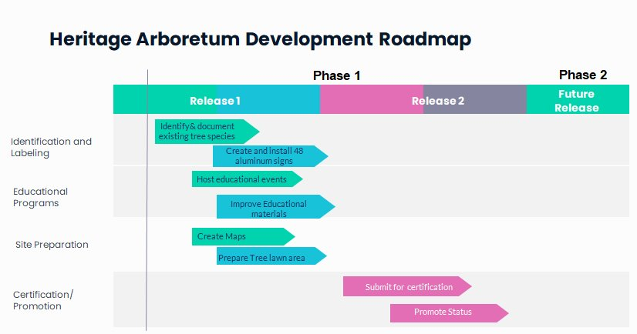
What does the product roadmap for the first year look like?

Slide 10
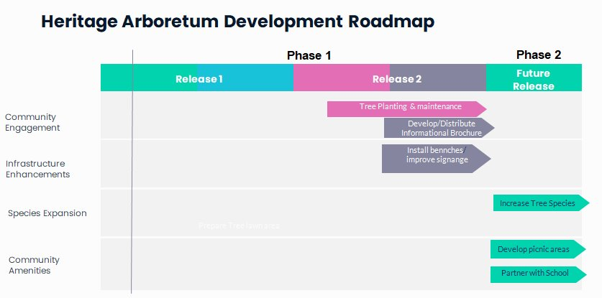
What does the product roadmap for the first year look like?

Slide 11
How can a sustainable pace be maintained for this project?
Setting Concrete and Achievable Objectives​
Flexible Planning with Quarterly Review Cycle​
Regular Checkpoints and Meetings​
Significant Achievements and Community Engagement​
Balancing Flexibility with Strict Planning and Communication

Slide 12
CONCLUSION
Implementing these Agile principles will streamline our Heritage Arboretum Development Project, enabling the team to efficiently meet certification goals. As a result, Anderson township will better position to cultivate a thriving, educational green space that will serve the community well into the future.

